Slide 1
Washington University in St. Louis willing to build out the space and host the Federal Statistical Research Data Center site
Conveniently located for all participants with paid parking and Metrolink access
Space available now and fully meets security, access, and square footage requirements ➔ ready for immediate fitting and construction
Washington University in St. Louis:
Proposed FSRDC Site
December 12, 2018

Slide 2
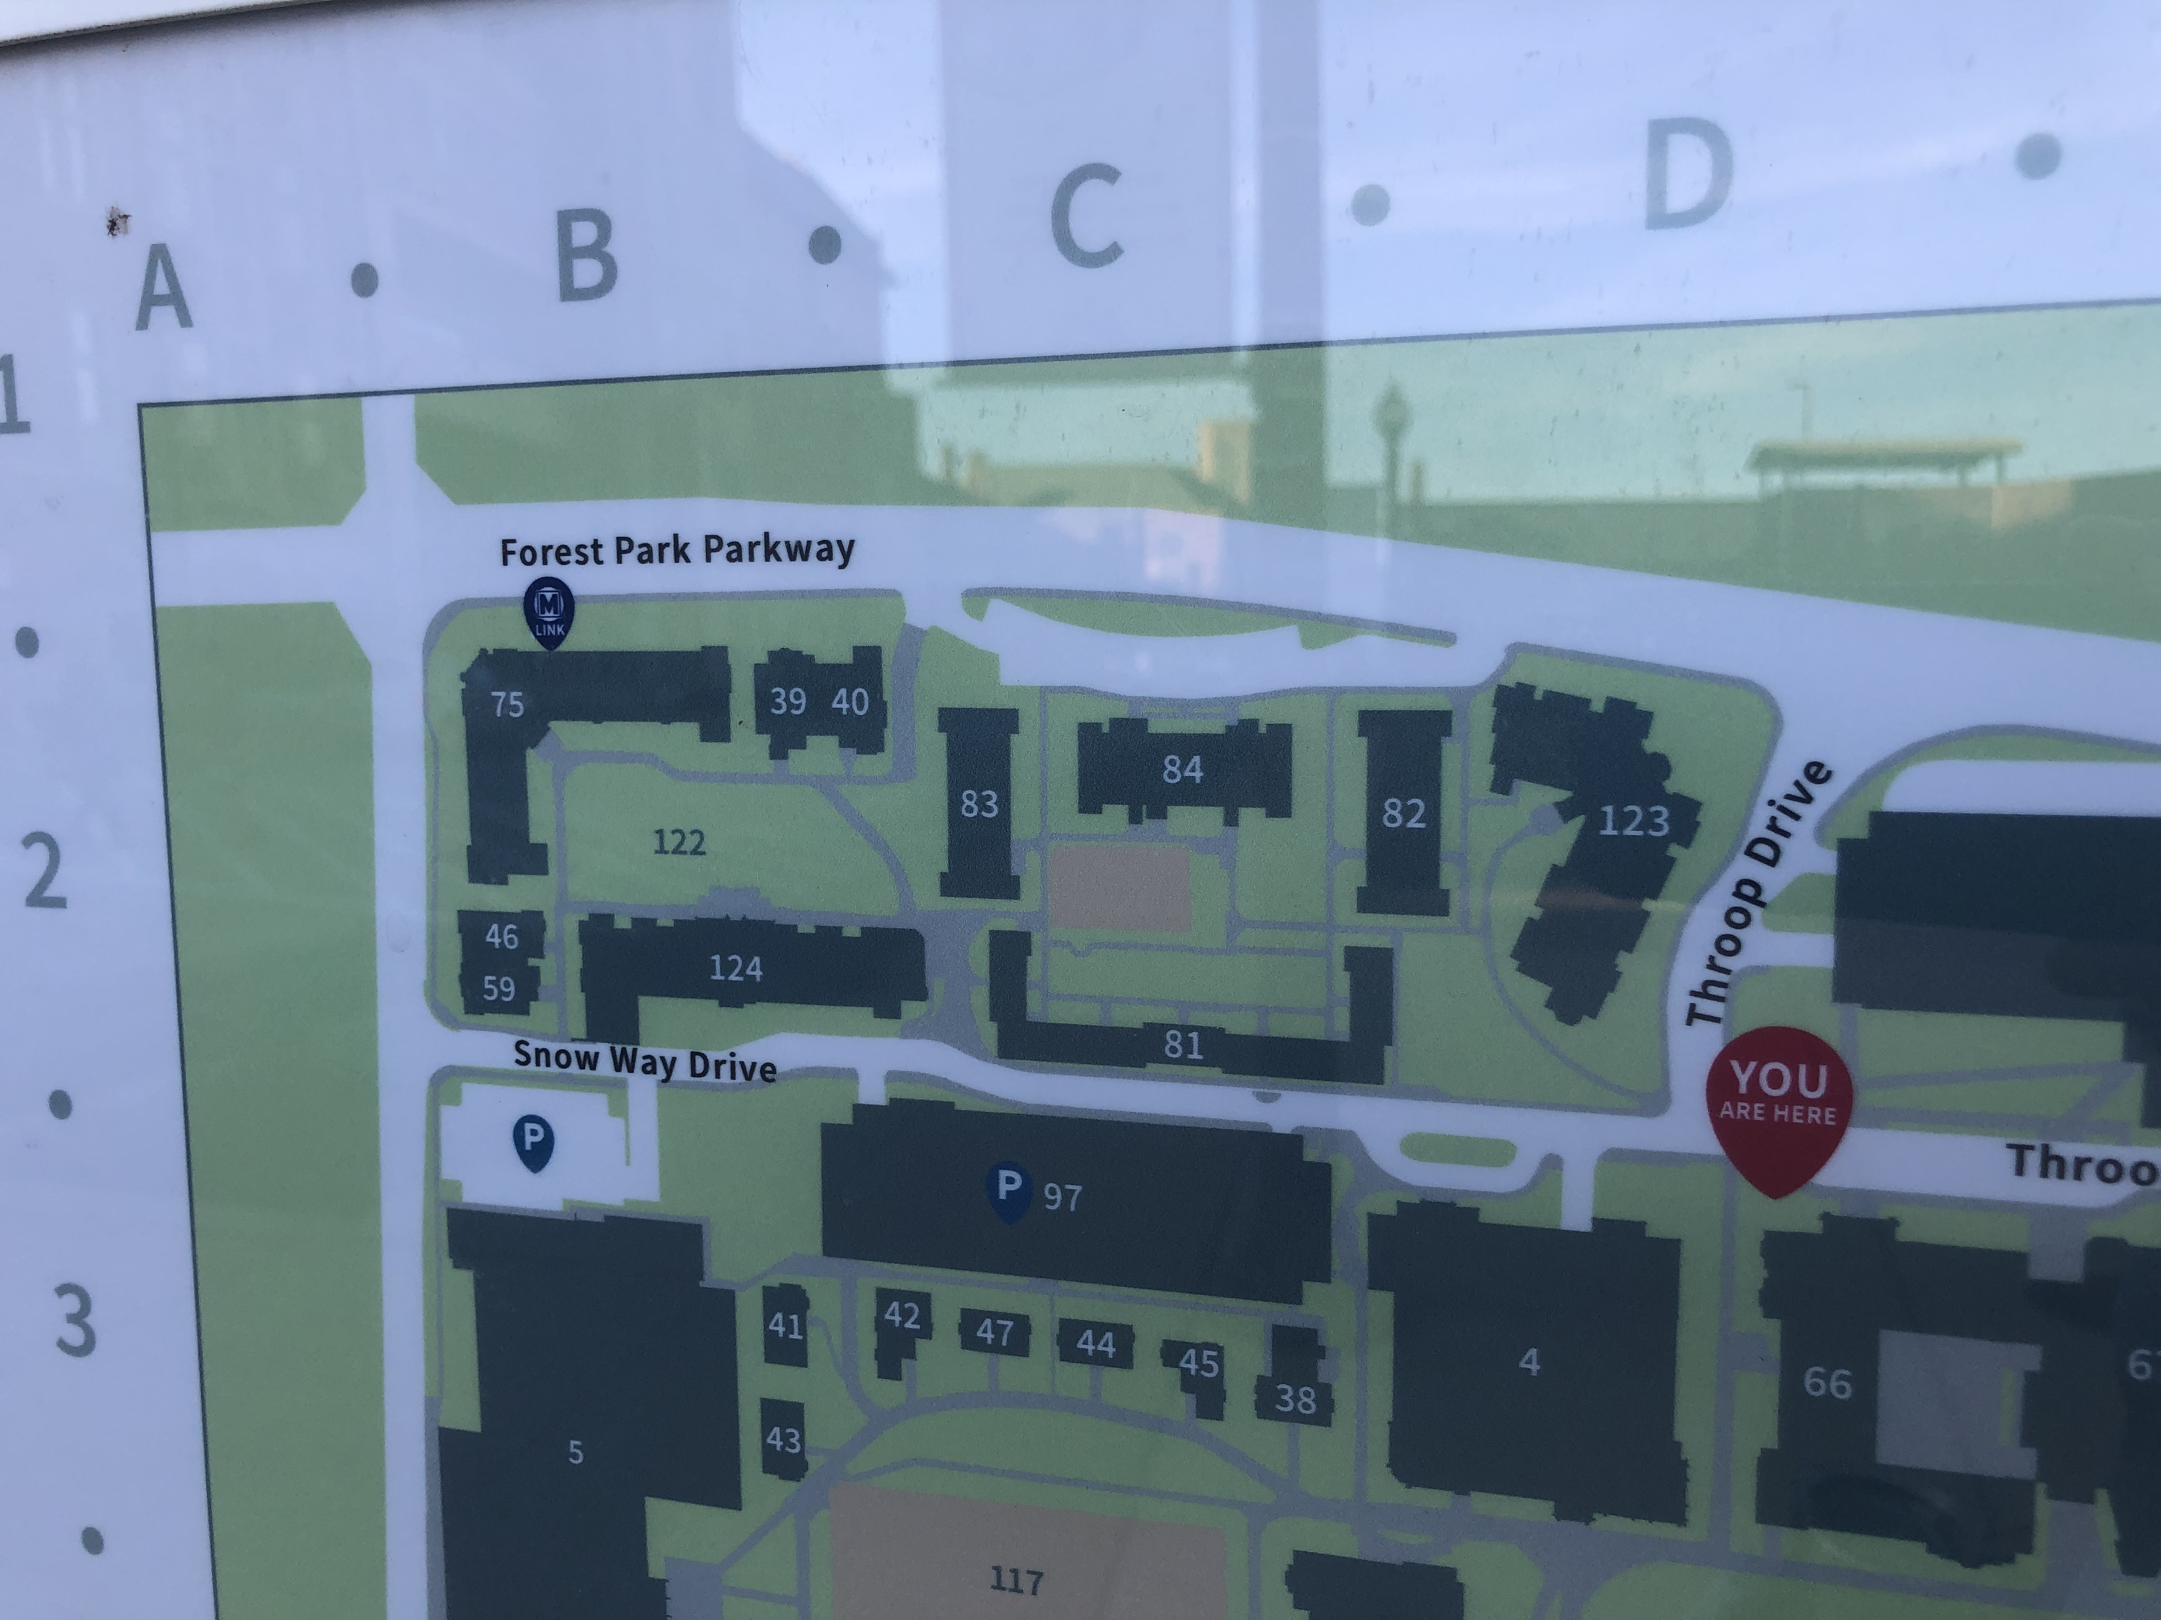
Secure Basement of Knight and Bauer Halls ➔ Convenient Location
Two paid parking garages, and Metrolink Station

Slide 3
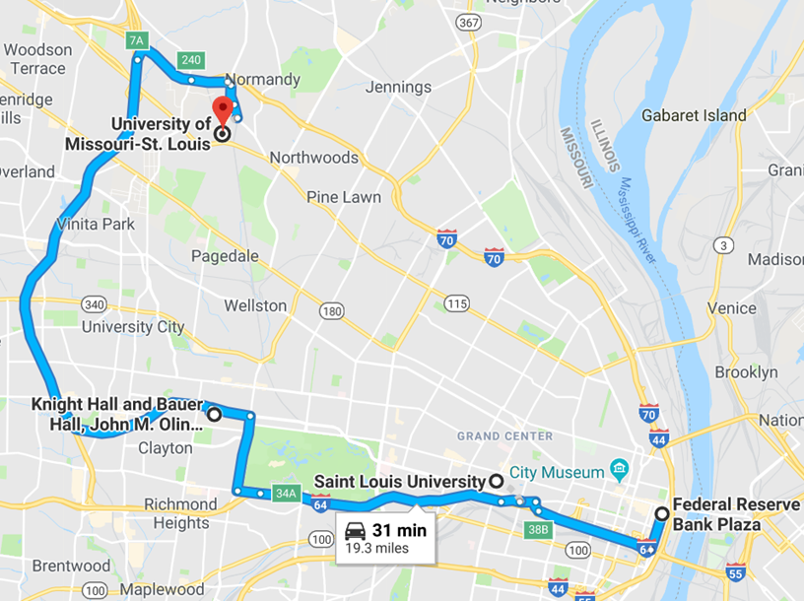
Location, location, location …
Conveniently connected by Forest Park Parkway, I-64 and I-170
Serves local players and traveling scholars from Lambert International Airport

Slide 4
Conveniently connected by Metrolink
Also serves local players and traveling scholars from Lambert International Airport

Slide 5
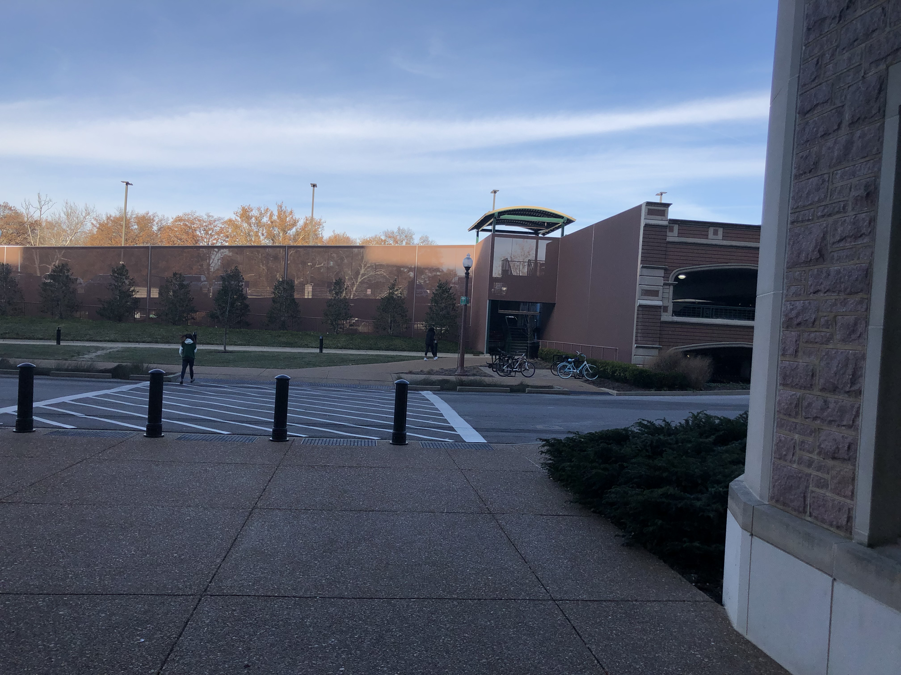
Photo Taken from Front Door of Knight Hall Entrance

Slide 6
Secure Space is Ready to Build Out
Square Footage Needs
KC: 1100 sq feet; 10 terminals, secure office
Chicago: ~850 sq feet in secure area
8 terminals
*6 offices
*Conference room
Requirements for a Secure Physical Space
- walls that establish a 360 degree perimeter with as few doors as possible
- walls that extend from “slab-to-slab”, that is, from floor-to-floor
- locks, bars, and/or security film (frosted glass) on every window and skylight
- solid-core doors
- bars or heavy mesh grating on any air ducts that lead into the RDC that are large enough to allow human passage
- access panels, partitions, and windows are fastened from inside the RDC

Slide 7
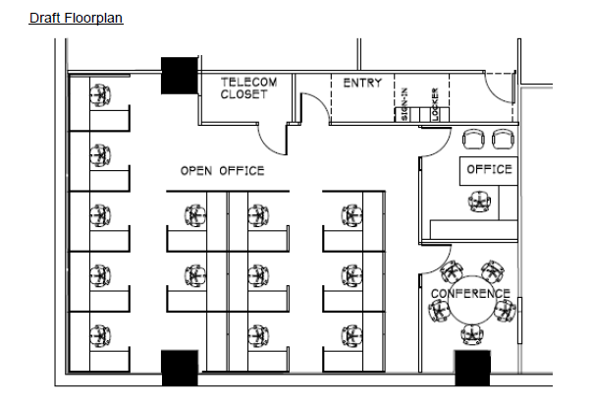
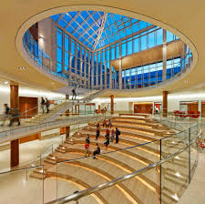
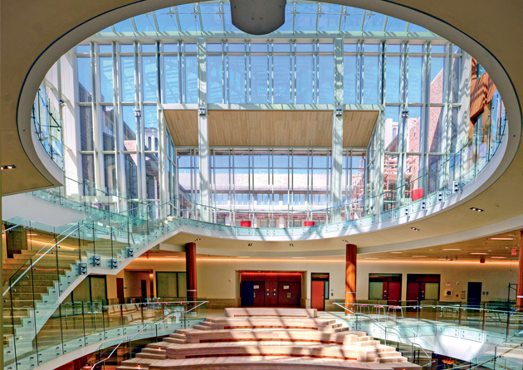
In the basement of the newly-constructed Knight and Bauer Halls, we have more than twice the space of Kansas City that is ready to begin re-fitting immediately.
And a Café and Starbucks on 3rd level…

Slide 8
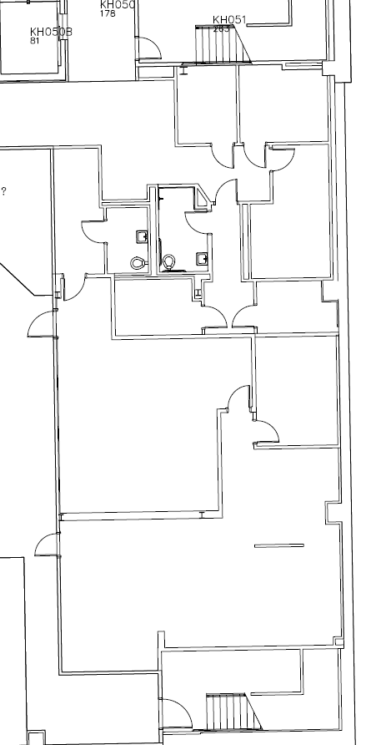
Over 2300 square feet of configurable space that includes conference tables, ED space, offices, locker room, and lavatories
Two security card access only stairwells
Two security card access elevators

Slide 9
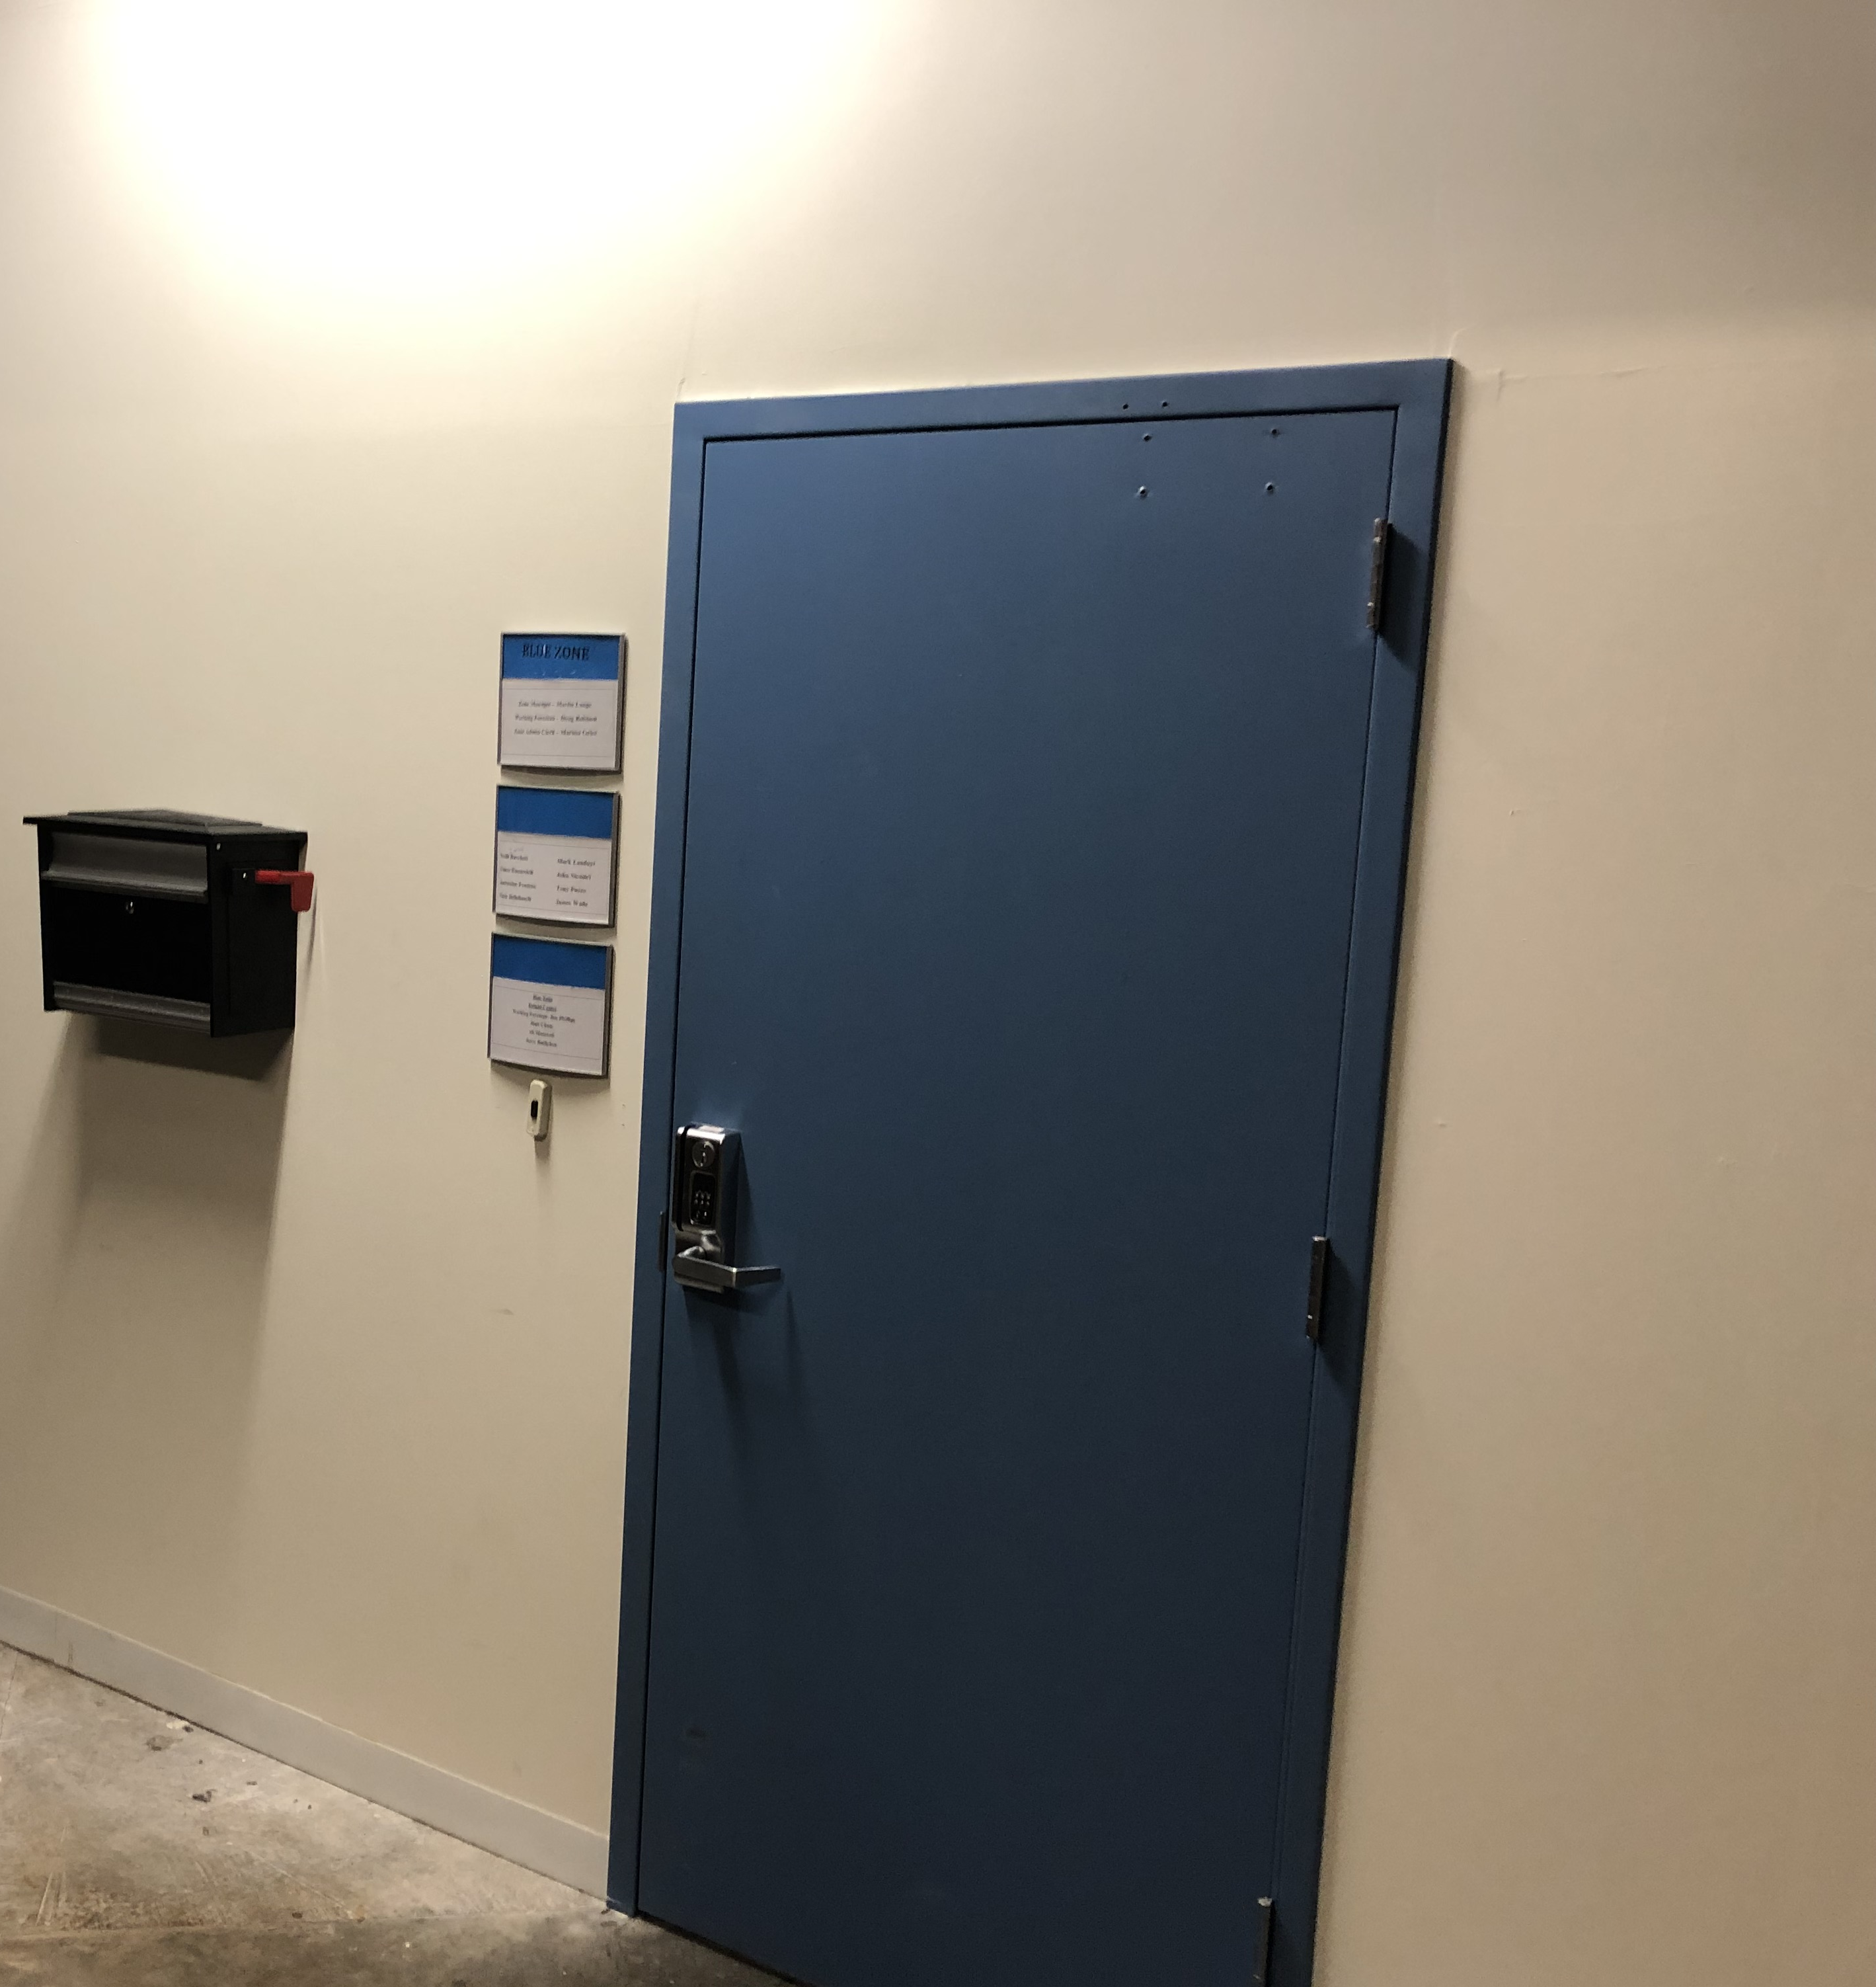
Secure Doors

Slide 10
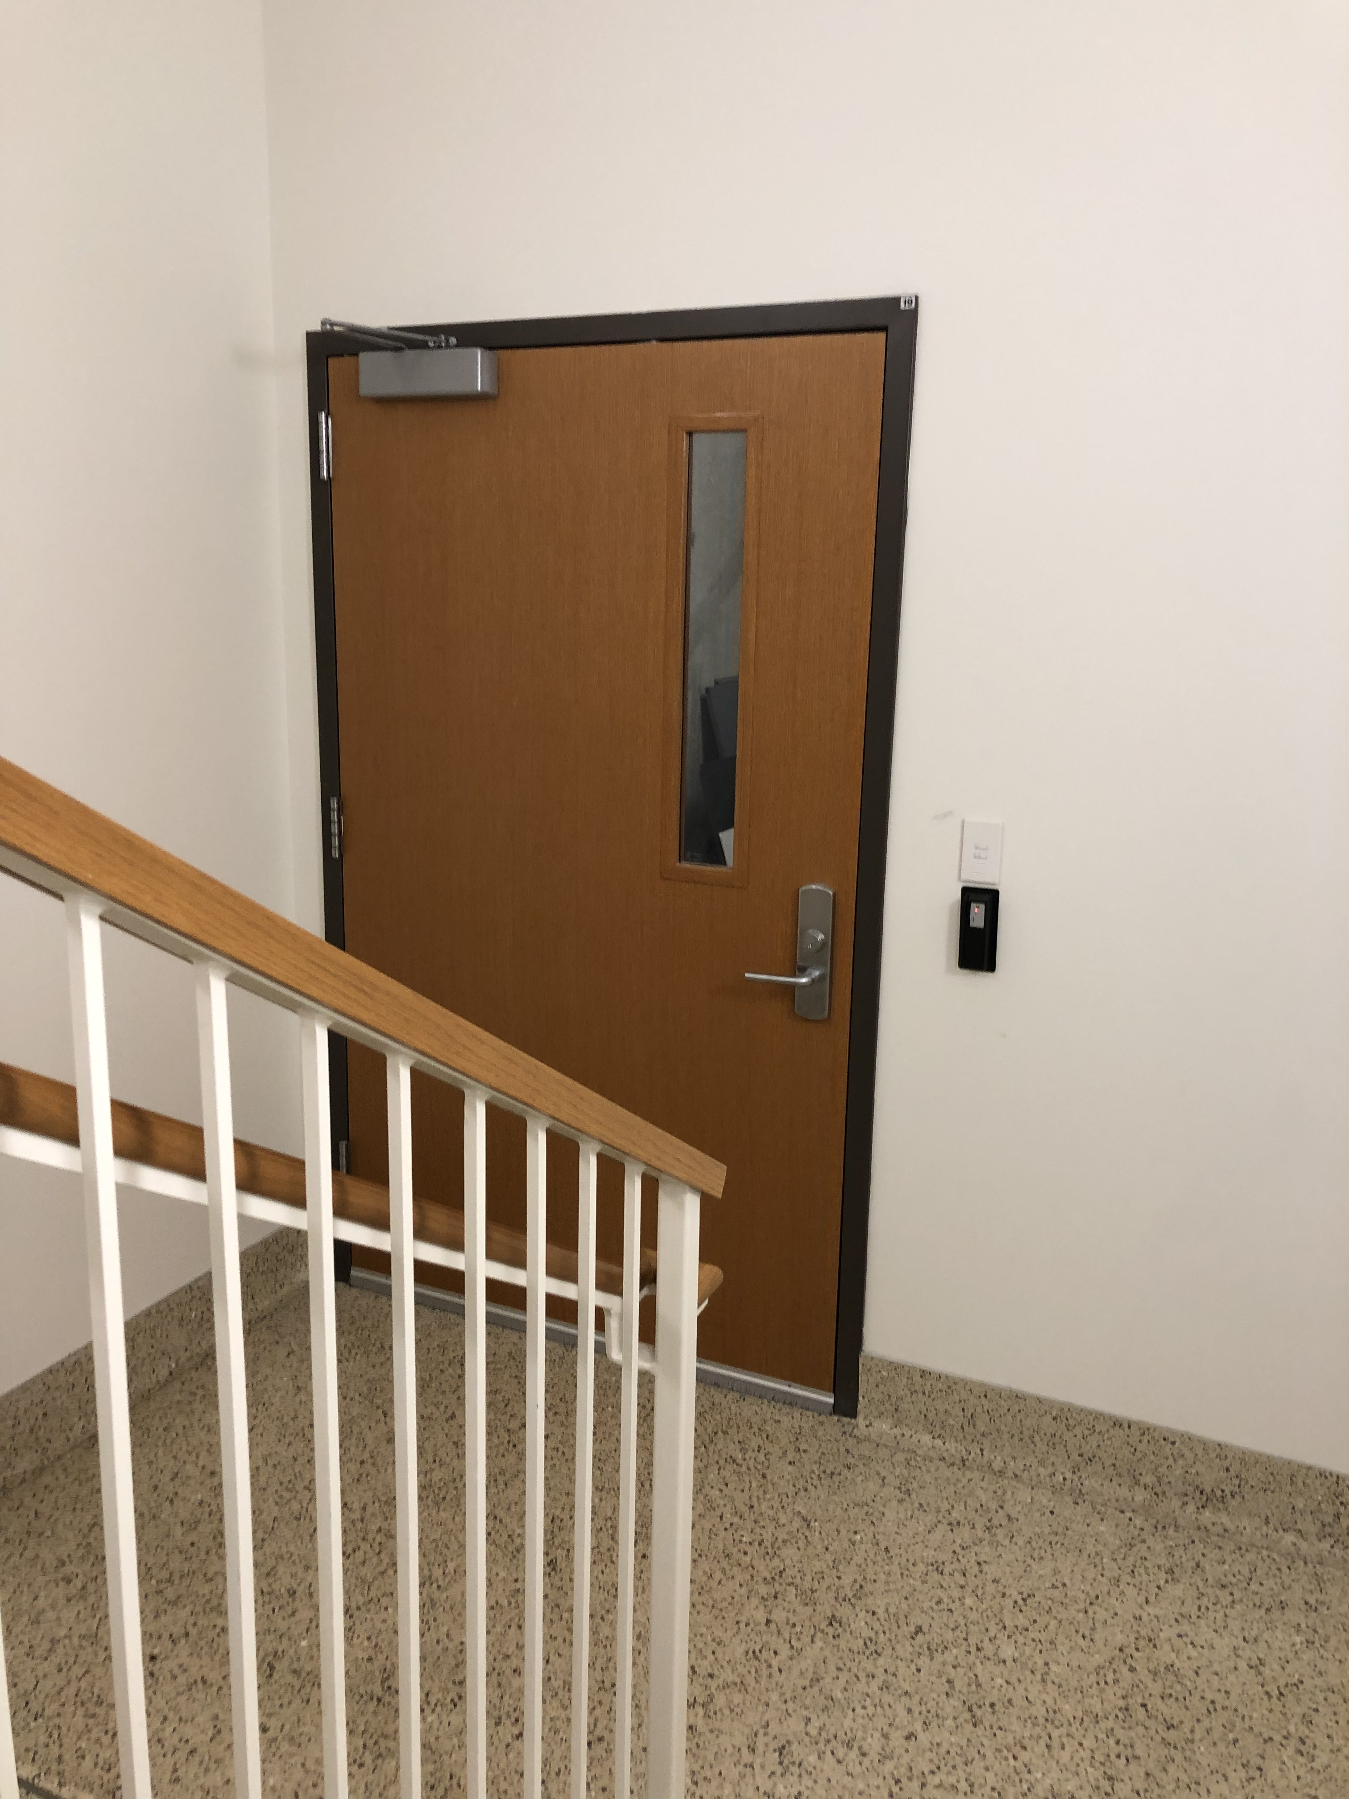
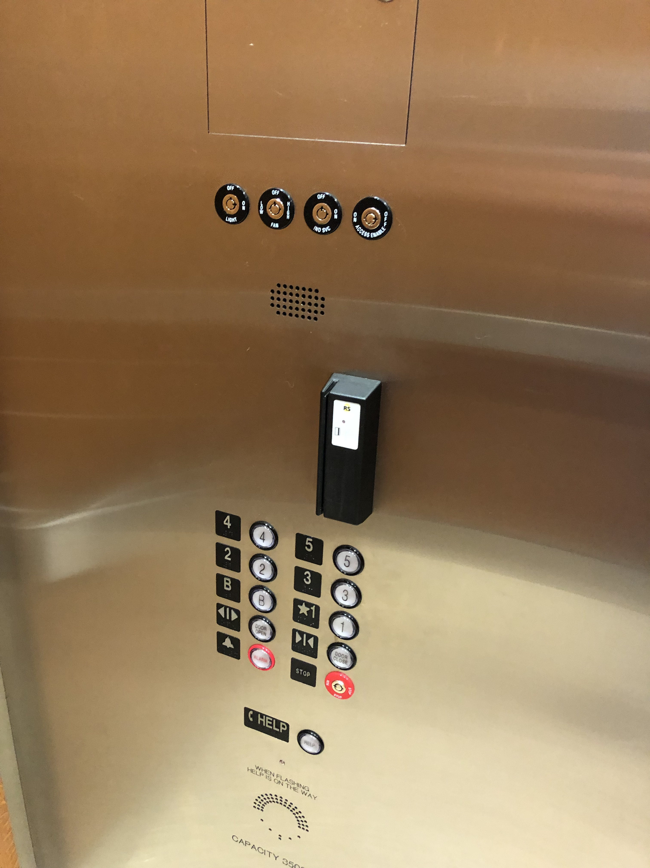

Slide 11
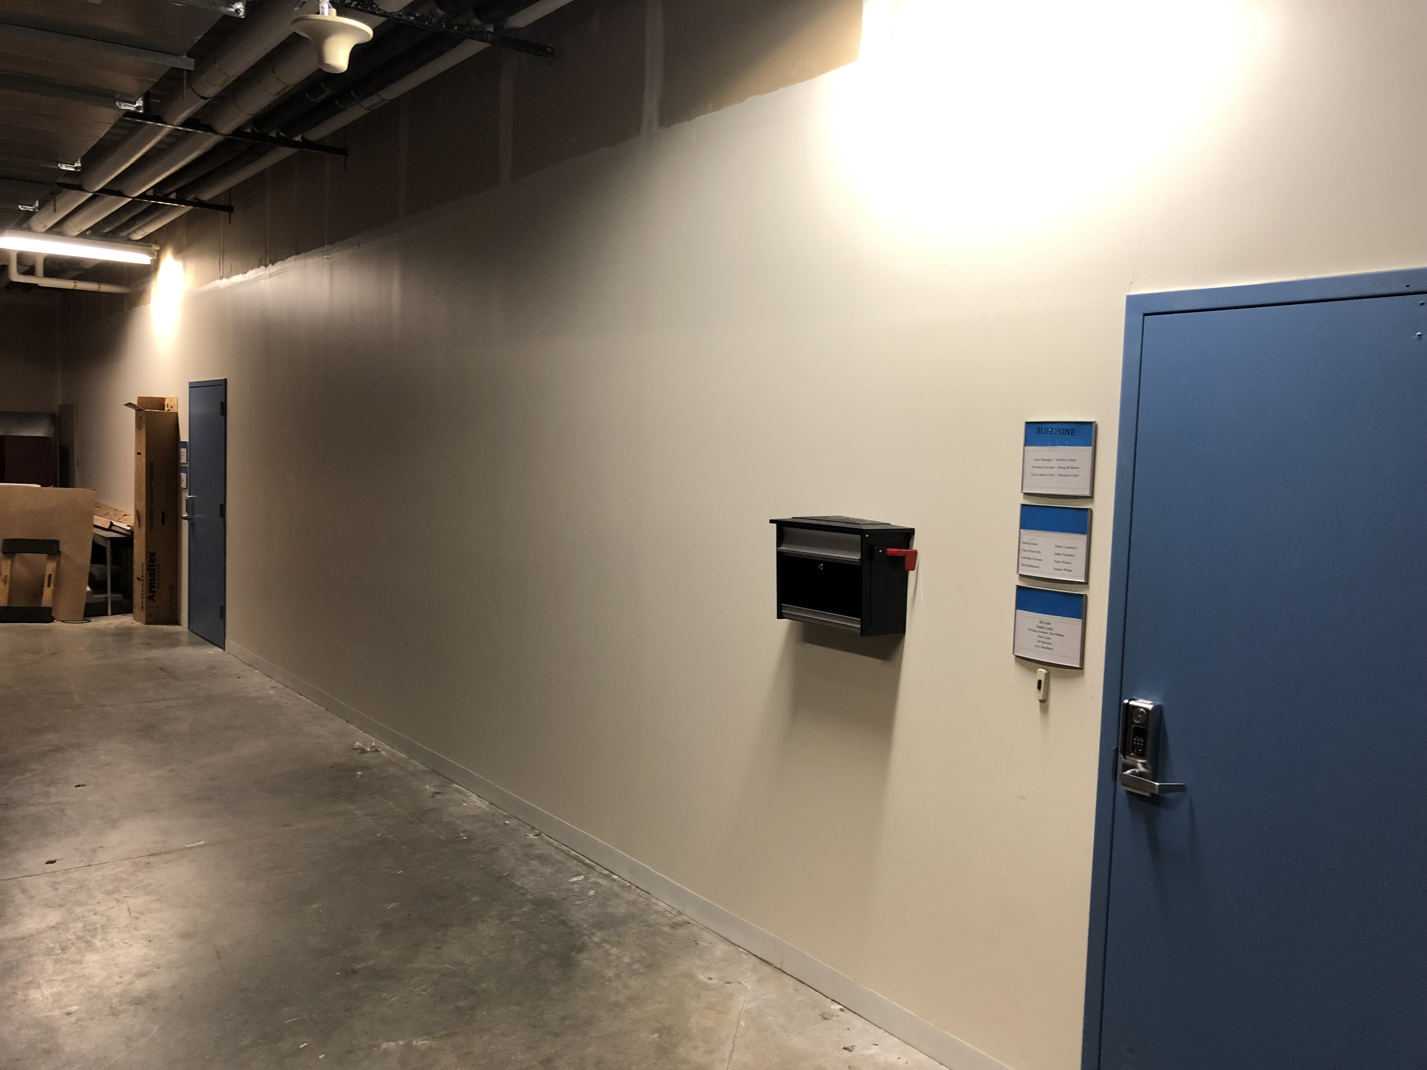
Floor to ceiling walls with concrete slabs top/bottom

Slide 12
Photo Taken from Front Door of Knight Hall Entrance

Slide 13
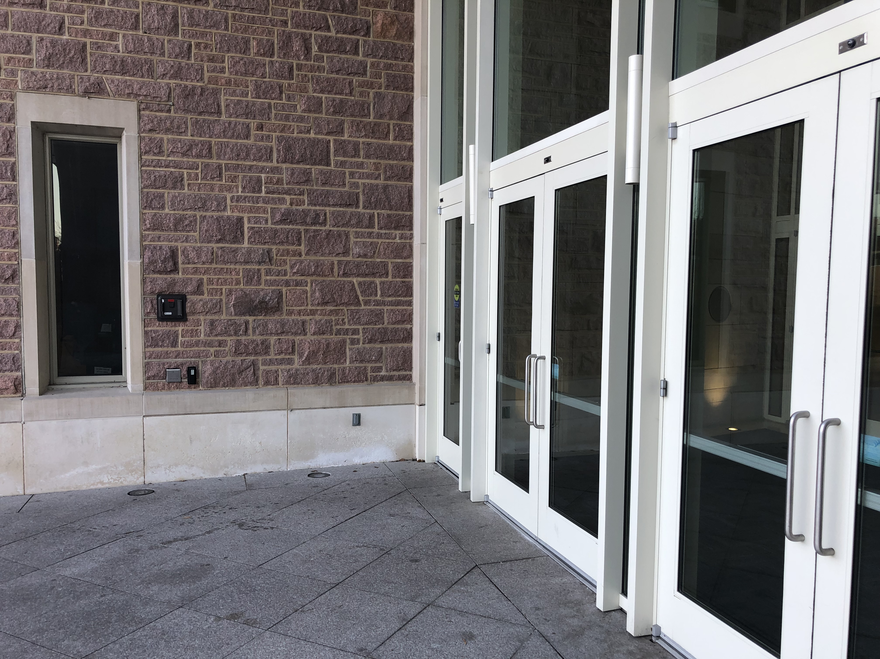
24-Hour Access

